Slide 1
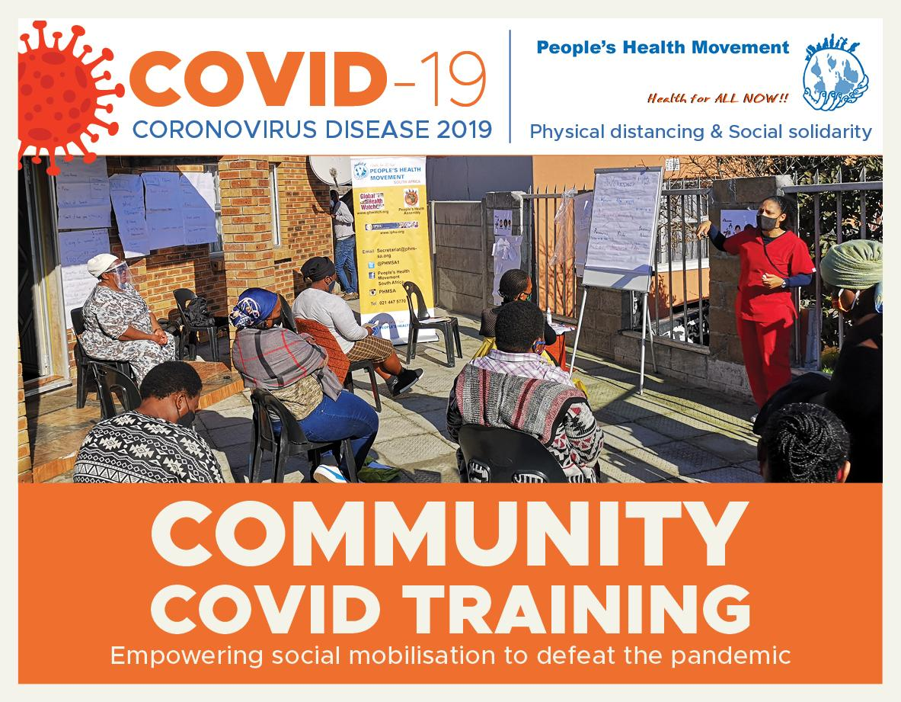

Slide 2



PROGRAMME OUTLINE:
Welcome & Introduction
Where are we now?
Vaccines. What are they?
Covid-19 Vaccines on the Horizon: Facts and Fiction
Barriers to Access
Community Questions

Slide 3
THE SOUTH AFRICAN HEALTH LANDSCAPE
Historic Inequality Land, wealth and housing. Lack of economic opportunity, infrastructure spending in non-white areas. “Causes of the causes of the causes” - social determinants of health.
Burden of disease Quadruple disease pattern: (1) High rates of Maternal, Newborn and Child Health conditions, (2) HIV/Aids and TB, (3) non-communicable diseases and (4) violence and injury.
Health Services Stretched Thin More than 25 years since democracy - yet many lack access to quality Primary Health Care. Many facilities are understaffed with a large urban-rural divide. Overcrowding, delays to care, stockouts are common etc.
Public-Private divide Corporate interests. Public sector cares for approx. 80% of population, while receiving <50% of funding. Even in the private sector costs of care are skyrocketing! Out-of-pocketcosts.

Slide 4
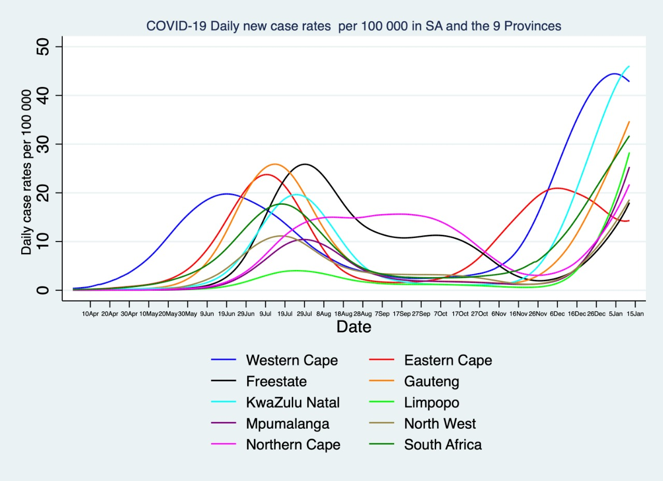
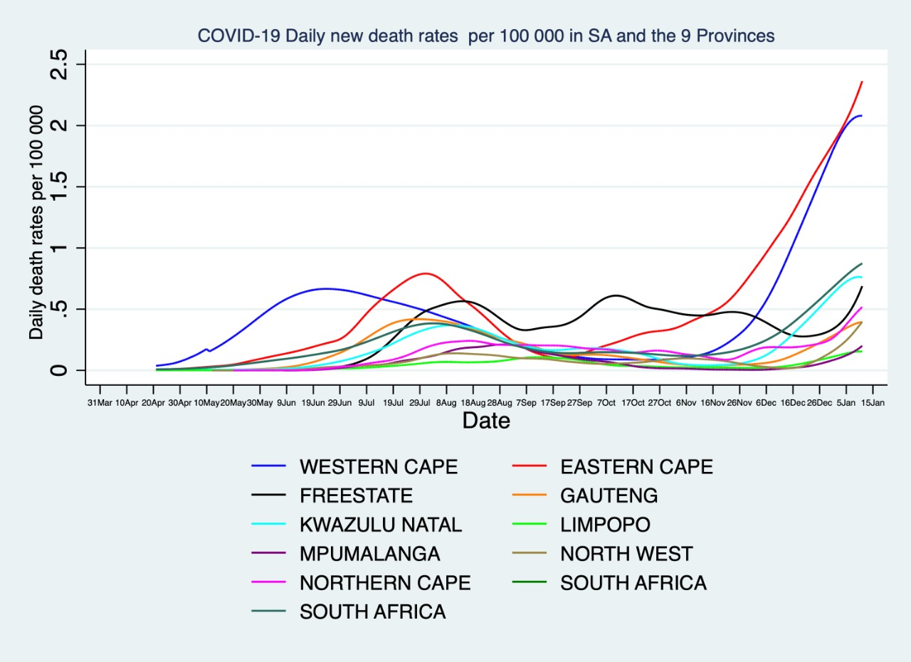

Slide 5
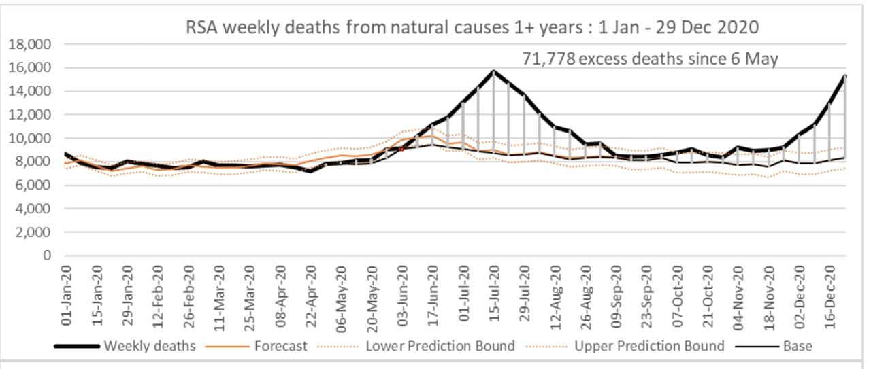
THE IMPACT: INDIRECT & DIRECT

Slide 6
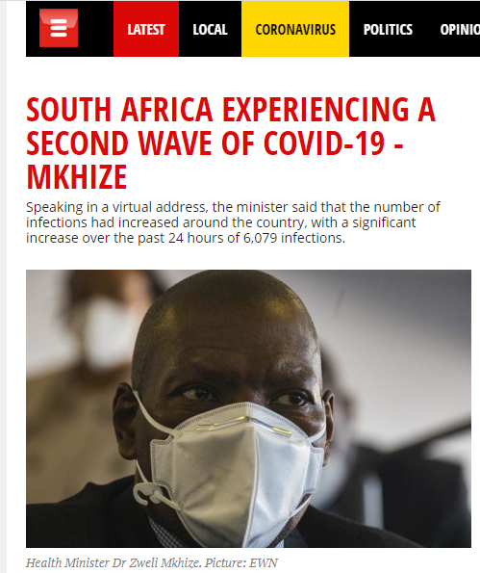
THE CURRENT SCENARIO
The “Second Wave” is Here!
Through the Festive Period
Increased gatherings
Inter-provincial travel
Covid-19 Fatigue
Pressure from business community
Exhaustion of Health Workers
4. Vaccine Rollout on the Horizon

Slide 7
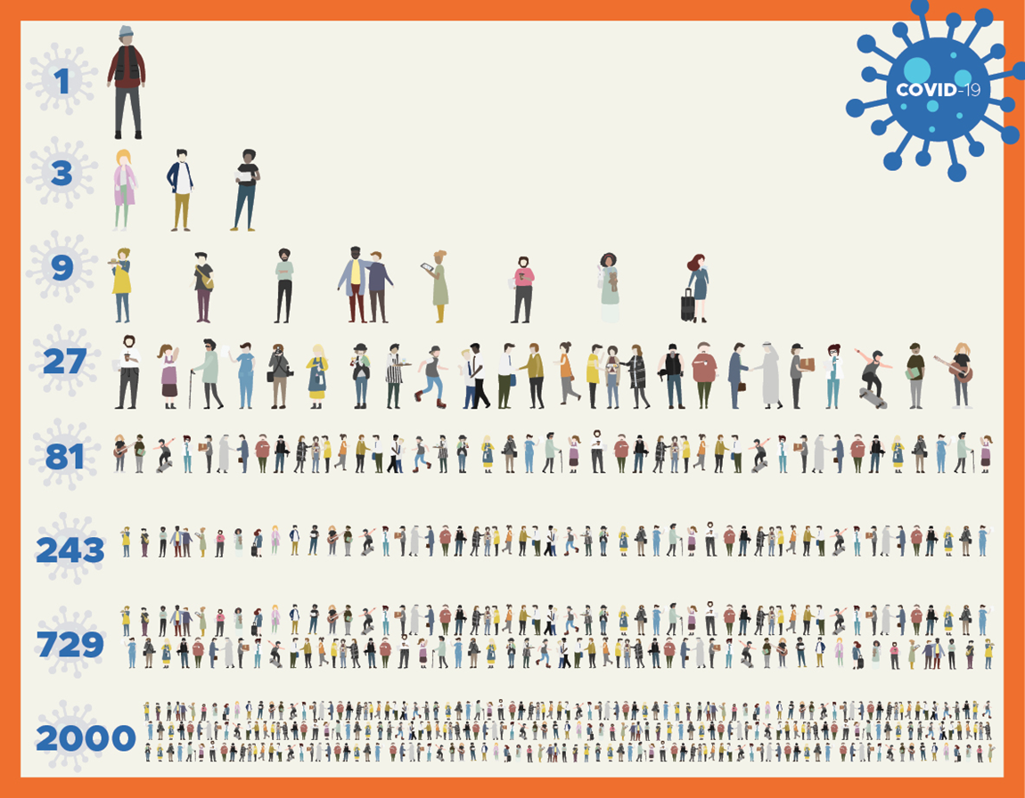
COVID-19 SPREADS QUICKLY
If 1 person gives the virus to (infects) 3
other people it can spread in a few months …

Slide 8
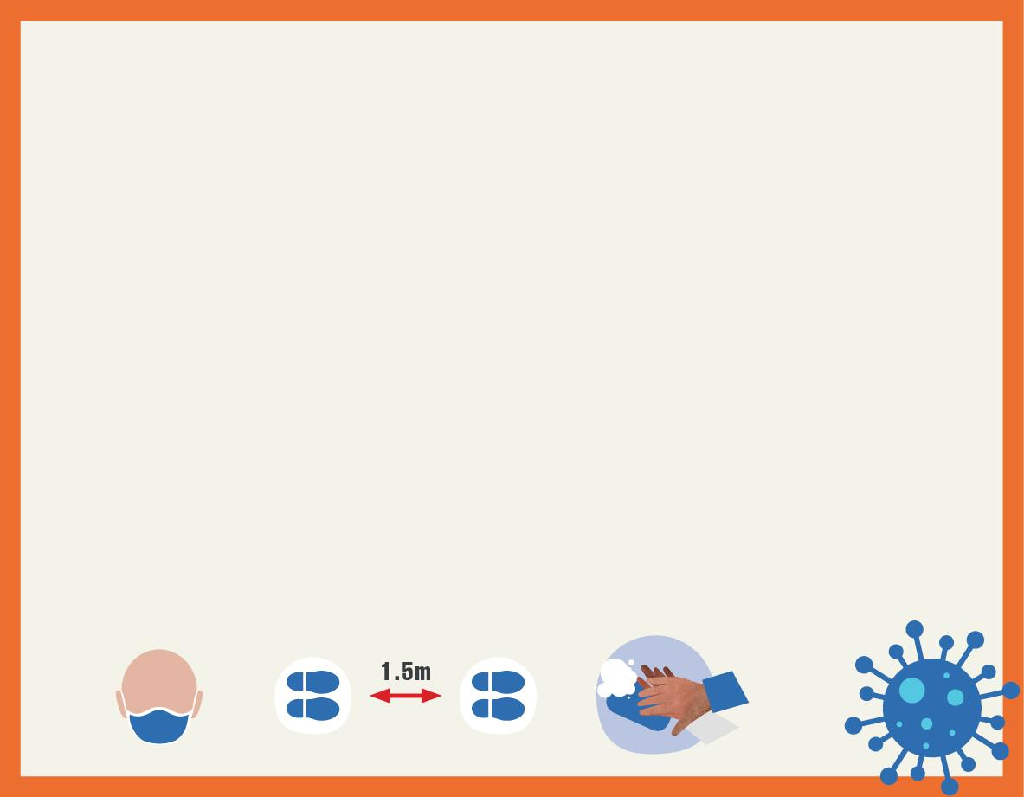
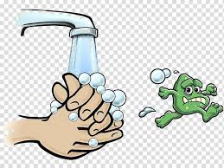
PREVENTION: Stopping spread to another person
Treat everyone as if they have COVID – INCLUDING YOURSELF!
Physical Distance 1.5 meters distance
2. Wear a Mask Good mask (2 or 3 layers of cloth), wear properly (over nose & mouth), wash daily, wash hands before putting on and taking off
3. Clean hands and surfaces Wash hands regularly with soap & water for 20 seconds OR use sanitiser (good amount and allow to dry, must be 70% or more alcohol). Clean surfaces with Jik.
4. Avoid crowds, especially indoors Don’t be with large
groups of people. If you must meet, better outside and in small groups
5. If sick with flu symptoms – STAY HOME (Isolate for at least 10 days)
Don’t spread COVID to another person.
Sleep in a separate room, use separate plates & spoon for eating.
Consider going to a COVID Care Centre to isolate

Slide 9
HOW ELSE CAN WE BREAK THE CHAIN?
ARE VACCINES AN OPTION?

Slide 10
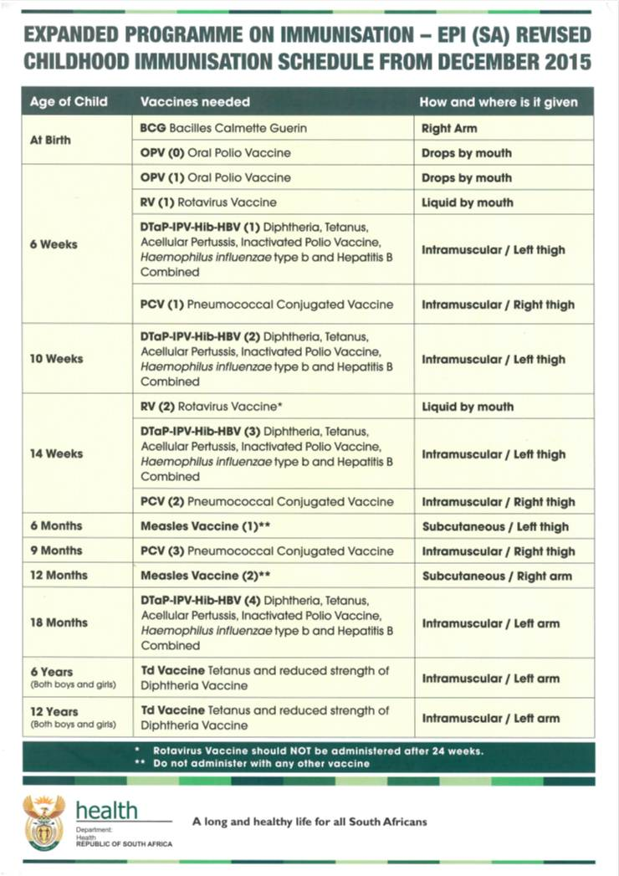
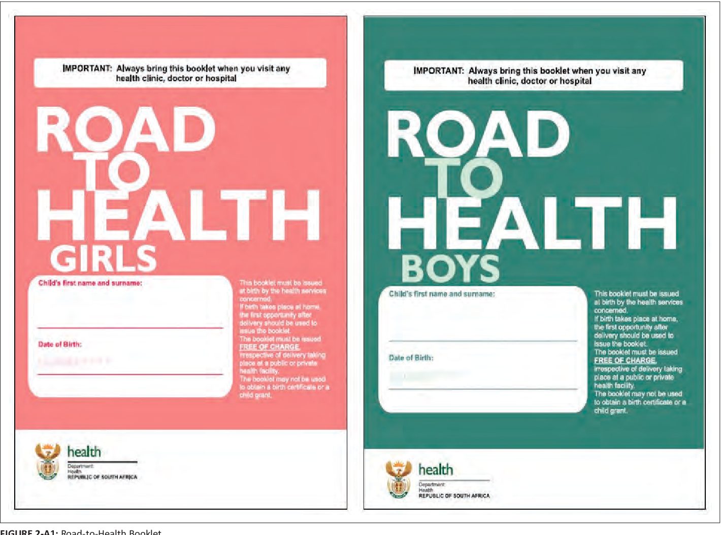
WHAT ARE VACCINES?
“Vaccines are designed to prevent disease. A vaccine is a type of medicine that trains the body’s immune system so that it can fight a disease it has not come into contact with before. “

Slide 11
Why do we use vaccines?
Vaccines save an estimated 2-3 million lives globally each year
To prevent people from contracting illnesses that can cause their deaths, or leave them with severe and life-long side-effects.
To prevent outbreaks of communicable diseases in populations
To protect people with weak immune systems from getting sick, e.g. older people and children
To limit drug resistance: when people get sick they have to take drugs/medicines. However, over time their bodies may become resistant to these medicines.
Notes:
https://wellcome.org/news/why-do-we-need-vaccines
23 September 2020

Slide 12
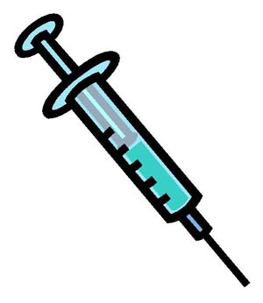

HOW DO VACCINES WORK?
Vaccines work by acting like an infectious agent
Different types: inactivated, component, killed - parts of the virus
Tested for safety - do not cause disease!
Generate an immune response (Immune cells are the bodies soldiers). They protect the body from future infection.
Y
Y
Y
Y
Y
Vaccines can help protect the vulnerable and control spread of many diseases!

Slide 13
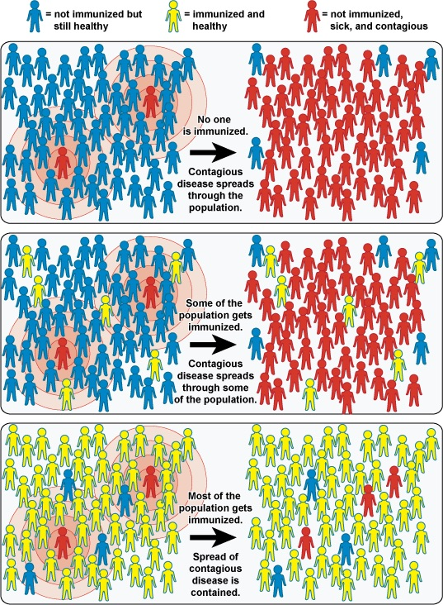
HERD PROTECTION/IMMUNITY
Need
70 - 90%
of all
people

Slide 14
WHAT ABOUT A COVID-19 VACCINE?
There is currently no Covid-19 Vaccine available to the general public in SA, but…
Many trials have shown effectiveness and the Government has committed to roll out
Some of the Vaccine Candidates:
Have different structures and are made in different ways, by different companies using different parts of the virus - BUT all work similarly in your body!
Pfizer Vaccine Has shown high effectiveness
Moderna Vaccine Has shown high effectiveness
Oxford / Astra Zeneca Vaccine Has shown high effectiveness. Testing done in South Africa. Chad-Ox 1
Sputnik V, etc

Slide 15
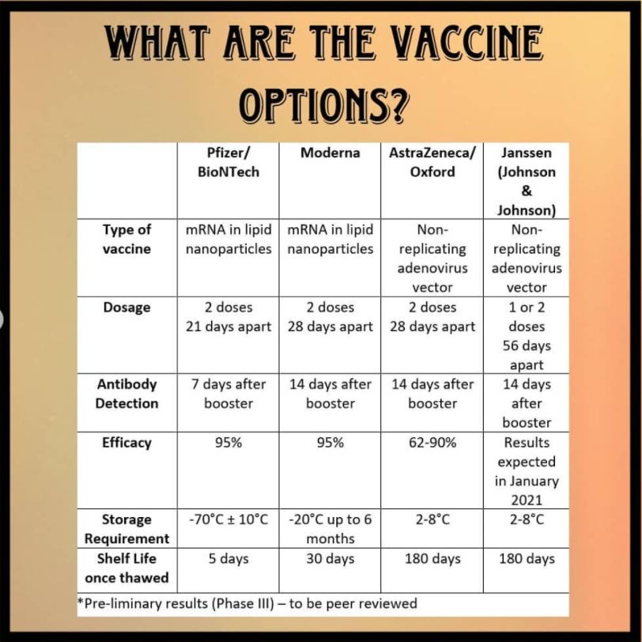
WHAT ARE THE VACCINE TYPES?
https://www.instagram.com/publichealthsa/

Slide 16
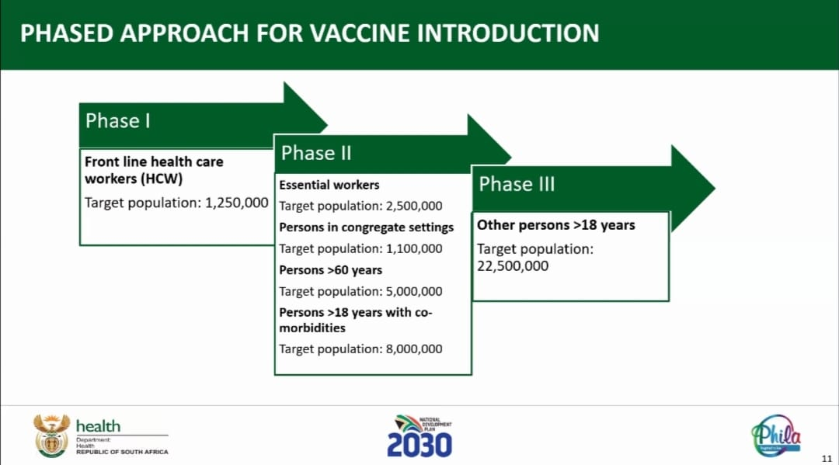
IS THERE AN SA VACCINE ROLL OUT PLAN?

Slide 17
What are the fears?
“Public health moves at the speed of trust,” Rishi Manchanda
In a survey conducted by Ipsos in mid-December, 47% of South Africans said they would refuse inoculation against the coronavirus.
The biggest vaccination campaign in history has begun. More than 30.5 million doses in 43 countries have been administered, according to data collected by Bloomberg. Delivering billions more will be one of the greatest logistical challenges ever undertaken.
The Anti-Vax Movement is a Billion dollar industry
Misinformation vs disinformation
Where is the info coming from?
Notes:
https://wellcome.org/news/why-do-we-need-vaccines
23 September 2020

Slide 18
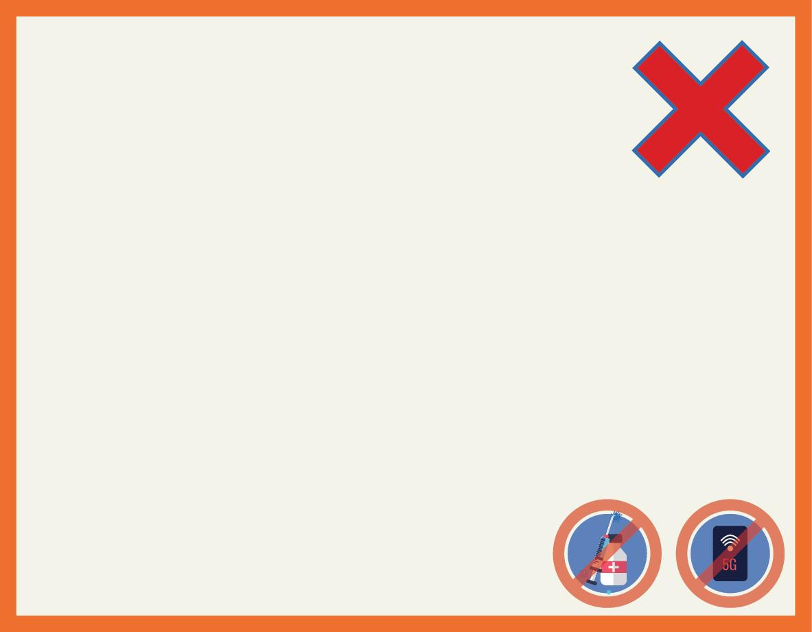
MYTHS (NOT TRUE)!
COVID-19 is not real
Physical distancing is neo-colonialism anti-Ubuntu
COVID is same as HIV (this leads to Stigma)
COVID comes from refugees & immigrants
COVID comes from 5G mobile phone networks
COVID is a conspiracy of government to control people
COVID is Chinese bio-terrorism against the world
Pharma companies caused COVID to make profit
Many Scams to steal money – for food parcels, SASSA grants
Bill Gates is manipulating COVID & vaccines for global control
Vaccines Have Implants to Track You, There are Satanic Symbols in Them
SA COVID rules are just an excuse for repression against the poor
Hydroxychloroquine is a cure or treatment for COVID
China is manipulating World Health Organisation
Tests for COVID actually spread COVID
Prayer and church pastors can cure COVID
SA Government is lying about COVID (many issues!)

Slide 19
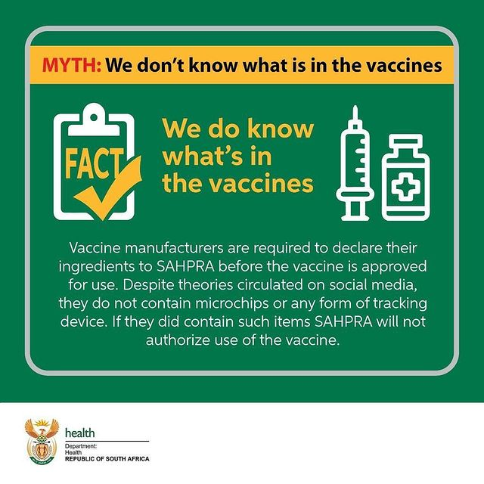
MYTHS (NOT TRUE)!

Slide 20
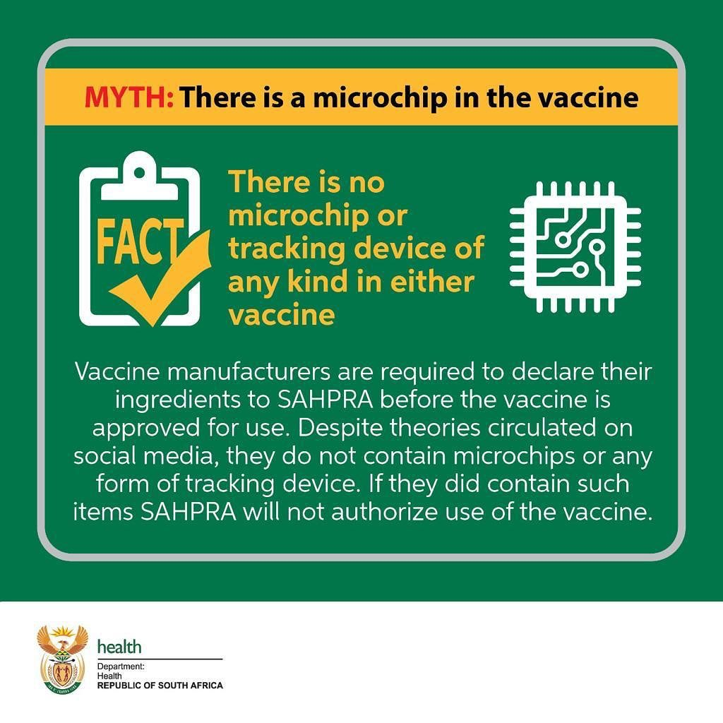
MYTHS (NOT TRUE)!

Slide 21
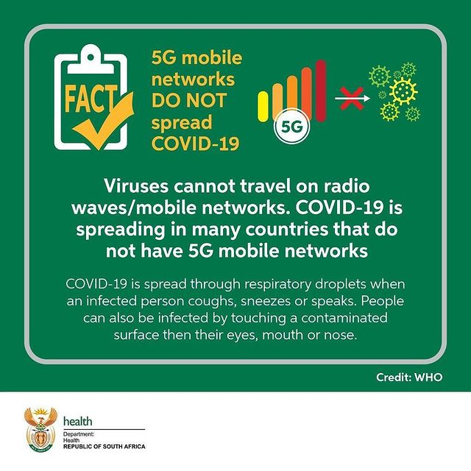
MYTHS (NOT TRUE)!

Slide 22
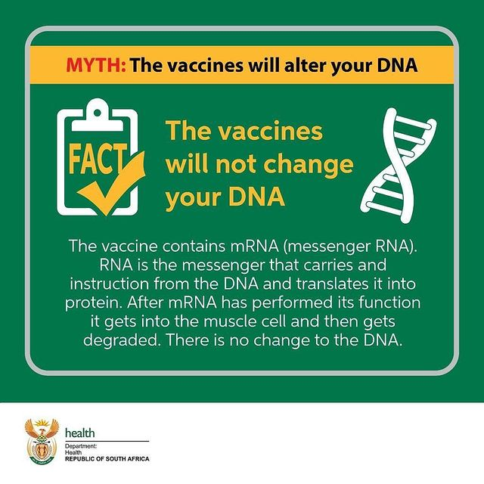
MYTHS (NOT TRUE)!

Slide 23
POINTS TO CONSIDER
C-19 is going to be with us for months / years to come!
There will be many challenges of cost, access & more
Access to Vaccines
Vaccines must be available and accepted by all
1. Vaccines are not a magic bullet
Need to educate people on masks, social distancing etc.
2. Many months before they will be widely available
Public sector, low income countries.
3. Lots of fear, stigma and FAKE NEWS!
How vaccines work, who they are available to?
4. Challenge any myths and rumours
Invasive, toxic, exploitative etc.
What have you heard?

